Slide 1
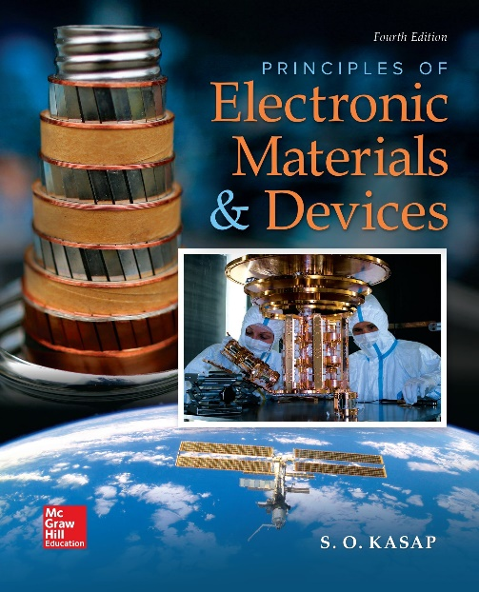
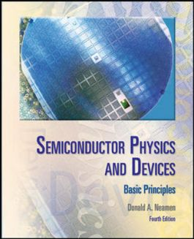

ELECTRONIC MATERIALS AND DEVICES
L | T | P | J | C
3 | 0 | 0 | 0 | 3
Dr. M. Saranya Nair
School of Electronics Engineering
VIT-Chennai Campus
E-mail : saranyanair.m@vit.ac.in
MODULE 7

Slide 2
ELECTRONIC MATERIALS AND DEVICES
MODULE 7
Other Electronic Materials

Slide 3
Dielectrics & Insulators
Dielectrics, in general, can be described as materials that are very poor conductors of electric current. They basically contain no free electron.
Dielectrics can be easily polarized when an electric field is applied to it.
When dielectrics are placed in an electric field, practically no current flows in them because, unlike metals, they have no loosely bound, or free, electrons that may drift through the material.
Instead, electric polarization occurs. The positive charges within the dielectric are displaced minutely in the direction of the electric field, and the negative charges are displaced minutely in the direction opposite to the electric field.
This slight separation of charge, or polarization, reduces the electric field within the dielectric.

Slide 4
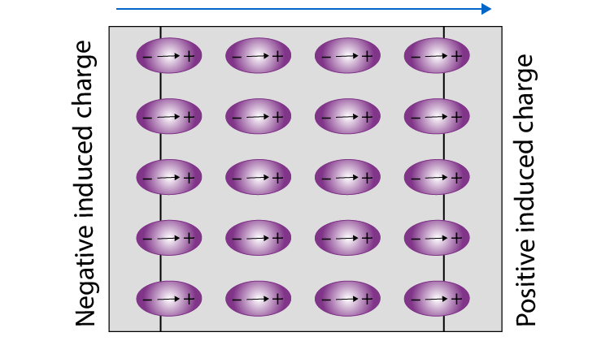
A dielectric may be made up of polar or non-polar molecules.
But the net effect of an external field is almost the same, i.e., the external field will compel the molecules to align their dipole moments along its own direction.

Slide 5
Electric susceptibility gives the measure of how easily a dielectric material can be polarized when placed in an electric field.
Properties of Dielectric Material
The energy gap in the dielectric materials is very large.
The temperature coefficient of resistance is negative.
The dielectric materials have high resistivity.
The attraction between the electrons and the parent nucleus is very strong.
The electrical conductivity of these materials is very low as there are no free electrons to carry current.

Slide 6
Dielectrics are often confused with insulators. The insulator typically implies low electrical conductivity. However, the term dielectric is typically used to denote the material with superior polarisability.
It is expressed numerically using relative permittivity.

Slide 7
Ferroelectric & Ferromagnetic Materials
Ferroelectric materials are materials that exhibit Ferroelectricity.
Ferroelectricity is the ability of the material to have a spontaneous electric polarization.
This polarization can be reversed by the application of an external electric field in the opposite direction.
Ferroelectric materials have some similarities over ferromagnetic materials, the hysteresis loop is almost the same for both materials.
Ferromagnetism, is a physical phenomenon in which certain electrically uncharged materials strongly attract others.

Slide 8
In contrast to other substances, ferromagnetic materials are magnetized easily, and in strong magnetic fields the magnetization approaches a definite limit called saturation.
When a field is applied and then removed, the magnetization does not return to its original value—this phenomenon is referred to as hysteresis.
Hysteresis occurs in a system that involves a magnetic field. Hysteresis is the common property of ferromagnetic substances.

Slide 9
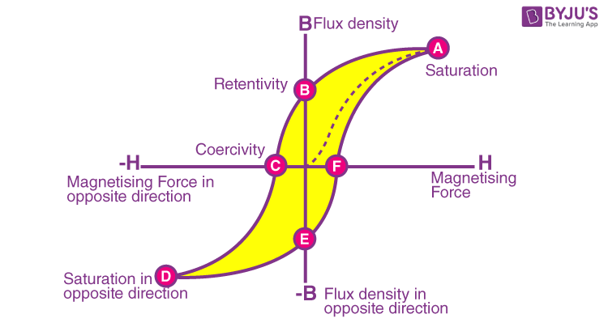

Slide 10
Looking at the graph, if B is measured for various values of H and if the results are plotted in graphic forms then the graph will show a hysteresis loop.
The magnetic flux density (B) is increased when the magnetic field strength(H) is increased from 0 (zero).
With increasing the magnetic field there is an increase in the value of magnetism and finally reaches point A which is called saturation point where B is constant.
With a decrease in the value of the magnetic field, there is a decrease in the value of magnetism. But at B and H are equal to zero, substance or material retains some amount of magnetism is called retentivity or residual magnetism.
When there is a decrease in the magnetic field towards the negative side, magnetism also decreases. At point C the substance is completely demagnetized.
The force required to remove the retentivity of the material is known as Coercive force (C).
In the opposite direction, the cycle is continued where the saturation point is D, retentivity point is E and coercive force is F.
Due to the forward and opposite direction process, the cycle is complete and this cycle is called the hysteresis loop.

Slide 11
Supercapacitors
Supercapacitors (SCs) are energy storage devices that bridge the gap between batteries and conventional capacitors. They can store more energy than capacitors and supply it at higher power outputs than batteries.
Supercapacitor is a charge storage device which stores electrical charge via electrochemical and/or electrostatic processes.
A supercapacitor (or ultracapacitor) differs from an ordinary capacitor in two important ways: its plates effectively have a much bigger area and the distance between them is much smaller.
The plates are made from metal coated with a porous substance such as powdery, activated charcoal, which effectively gives them a bigger area for storing much more charge.
A Supercapacitor is a device which can store electrical energy quickly and discharge slowly. We know that the normal capacitors like Electrolytic Capacitor, Ceramic Capacitor etc can store electrical energy very quickly and discharge also very quickly but the supercapacitor does not the same. The Supercapacitor is also called Ultracapacitor or Electrical Double Layer Capacitor(EDLC).

Slide 12
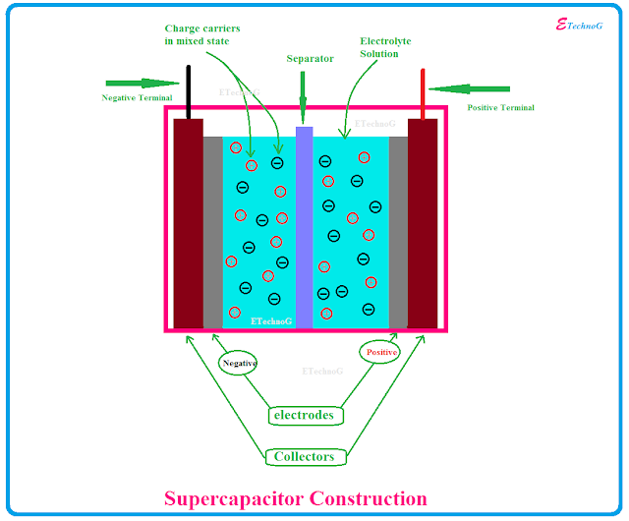
Construction
In a supercapacitor, there is no dielectric as such.
Instead, both plates are soaked in an electrolyte and separated by a very thin insulator (which might be made of carbon, paper, or plastic). The electrolyte contains positive and negative ions.
These plates are coated with activated carbon which is a sponge-like porous material. During charging, ions from the electrolyte accumulate on the surface of each carbon-coated plate. (adsorption)
When the plates are charged up, an opposite charge forms on either side of the separator, creating what's called an electric double-layer.
This is why supercapacitors are often referred to as double-layer capacitors, also called electric double-layer capacitors or EDLCs.

Slide 13
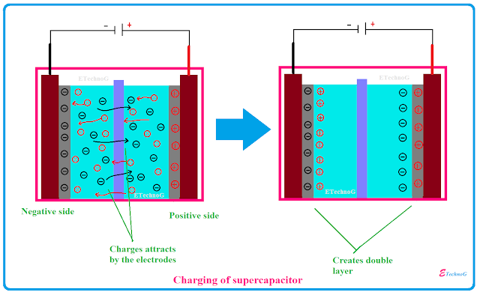
Super capacitors – Charging
We already know that the positive and negative Ions are present in the electrolyte solution with mixed in.
So at first when we apply a voltage across the electrodes of the supercapacitor then it starts charging. The electrodes start to attract the Ions of opposite polarity. (adsorption)
That means the positive electrode attracts the negative Ions or charges and the negative electrode attracts the positive Ions or charges. As a result, the positive ions or charges creates a layer near the negative electrode and the negative ions create a layer near the positive electrode.
As there two layers is formed by the electrical charge carriers that is why it is called Electrical Double Layer Capacitor(EDLC).

Slide 14
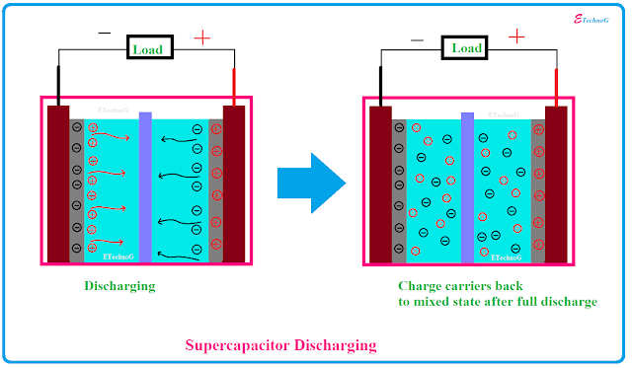
Discharging of Supercapacitors
When we connected a load across the supercapacitor, the electrodes cannot attract the ions and the ions start distributing through the electrolyte solutions and go to the mixed state. (desorption)

Slide 15
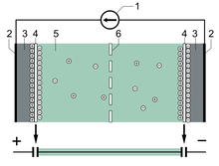
Capacitance Distribution
The two electrodes form a series circuit of two individual capacitors C₁ and C₂. The total capacitance C_{total} is given by the formula
Supercapacitors may have either symmetric or asymmetric electrodes. Symmetry implies that both electrodes have the same capacitance value, yielding a total capacitance of half the value of each single electrode (if C₁ = C₂, then C_{total} = ½ C₁). For asymmetric capacitors, the total capacitance can be taken as that of the electrode with the smaller capacitance (if C₁ >> C₂, then C_{total} ≈ C₂).

Slide 16
Advantages
➨It offers high energy density and high power density compare to common capacitor. ➨It offers high capacitance (From 1 mF to >10,000F) . ➨It offers fast charging ability. ➨It offers superior low temperature performance (from -40ºC to 70ºC). ➨It offers longer Service and long life (about 10 to 15 years compare to 5-10 years of Li-ion battery). It can be cycled millions of time. ➨It reduces size of the battery, its weight and consecutively cost. ➨Supercapacitors meet environmental standards. Hence they are eco-friendly.

Slide 17
Disadvantages
➨They have higher self discharge rate. This is considerably high compare to battery. ➨Amount of energy stored per unit weight is considerably lower compare to electrochemical battery.
➨It can not be used in higher frequency circuits.

Slide 18
Applications
Supercapacitors are used in applications requiring many rapid charge/discharge cycles, where they are used for regenerative braking, short-term energy storage, or burst-mode power delivery.
Supercapacitors are used in the following:
Electric cars
Wind turbines
Photographic flash
Flywheel in machines
MP3 players
Regenerative braking in the automotive industry
Static memories (SRAM)
Industrial electrical motors

